Slide 1
Python Powered Geoprocessing
My Journey to Geoflip

Slide 2
Setting the Scene
My Enterprise Roots
14 years as a GIS professional
Government Agencies
Private Sectors
My main toolkit
Need a map? ArcGIS Pro/Map
Geoprocessing? FME/ArcGIS
Storage? Well that’s ArcSDE
Python?
Mostly arcpy and FME PythonCaller
Notes:
I’ve spent the last 14 years as a GIS consultant at NGIS, working across government and private sectors.
For most of that time, my default toolkit was Enterprise GIS:
Need a map? Fire up ArcGIS Pro.
Need geoprocessing? Use FME or ArcGIS Geoprocessing Services.
Need data storage? Well, that’s ArcSDE or enterprise geodatabases.
This was the world I knew — and it worked great... if you had the licensing.

Slide 3
When licensing wasn’t an option
Doing without traditional enterprise tech
Manual QGIS Workflows
Solve desktop issues using manual QGIS workflows
Ad-hoc python scripts
Difficult/Expensive to maintain
Once off data packages
Using NGIS licensing
Ongoing consulting costs
Notes:
Over the years, I’d occasionally run into clients who didn’t have access to the full enterprise stack — whether it was budget constraints, procurement red tape, or just not wanting to lock themselves into platforms like FME or ArcGIS Enterprise.
In those situations, we’d either have to:
Try solve it manually using shapefiles and spreadsheets, or
Write ad-hoc Python scripts to get the job done.
It wasn’t ideal, but it planted a seed — I started to realise that open source tooling could fill the gap… if I could figure out how to string it all together.

Slide 4
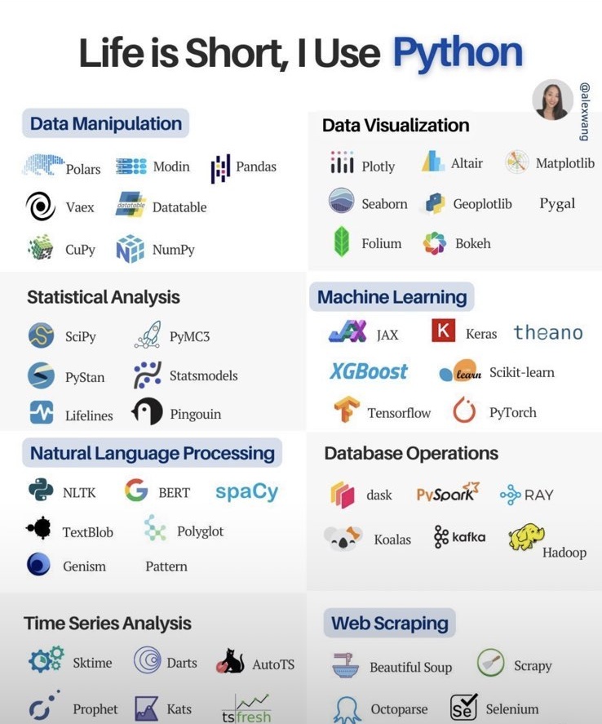
Python Has Everything
Theres a library for that!
Python Based Geoprocessing Libraries:
Fiona – reading/writing spatial data (thanks GDAL!)
Shapely – all the geometry processing and spatial operations
GeoPandas – the glue that brings it all together with geodataframes
Notes:
I did look at python a little deeper and yes there are libraries for really anything you’d like to do

Slide 5
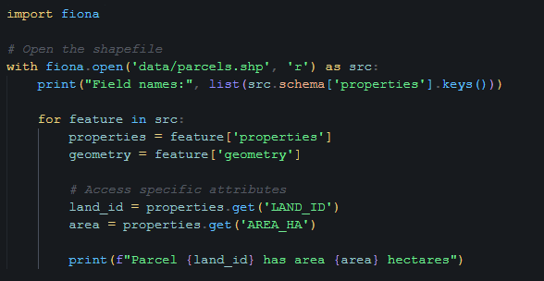
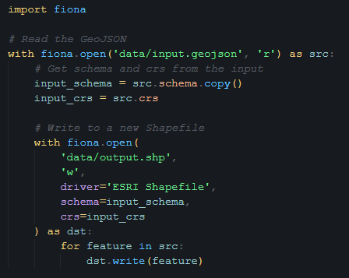
Fiona
A wrapper for GDA/OGR – Read/Write Spatial data
Notes:
Read a shape file and look at the data inside of it
Read geojson and write to a shapefile

Slide 6
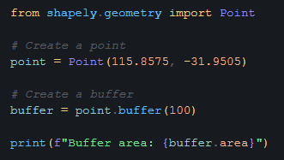
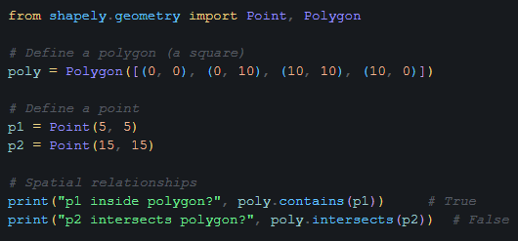
Shapely
Spatial transformations (buffer, union, intersect/clip)
Notes:
Buffering
Intersect

Slide 7
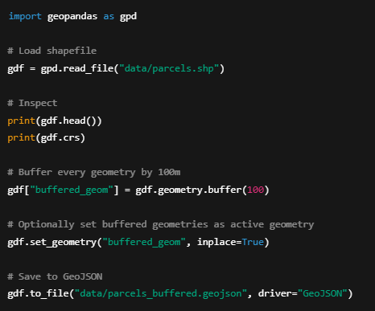
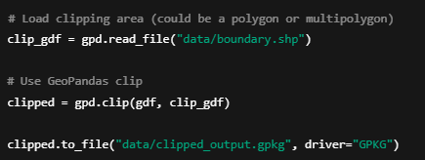
Geopandas
Bringing it all together with geodataframes
Pandas DataFrame + Geometry column + Spatial awareness
Notes:
Geopandas makes it easy
Don’t need ot handle individual geometries
Geodataframe concept

Slide 8
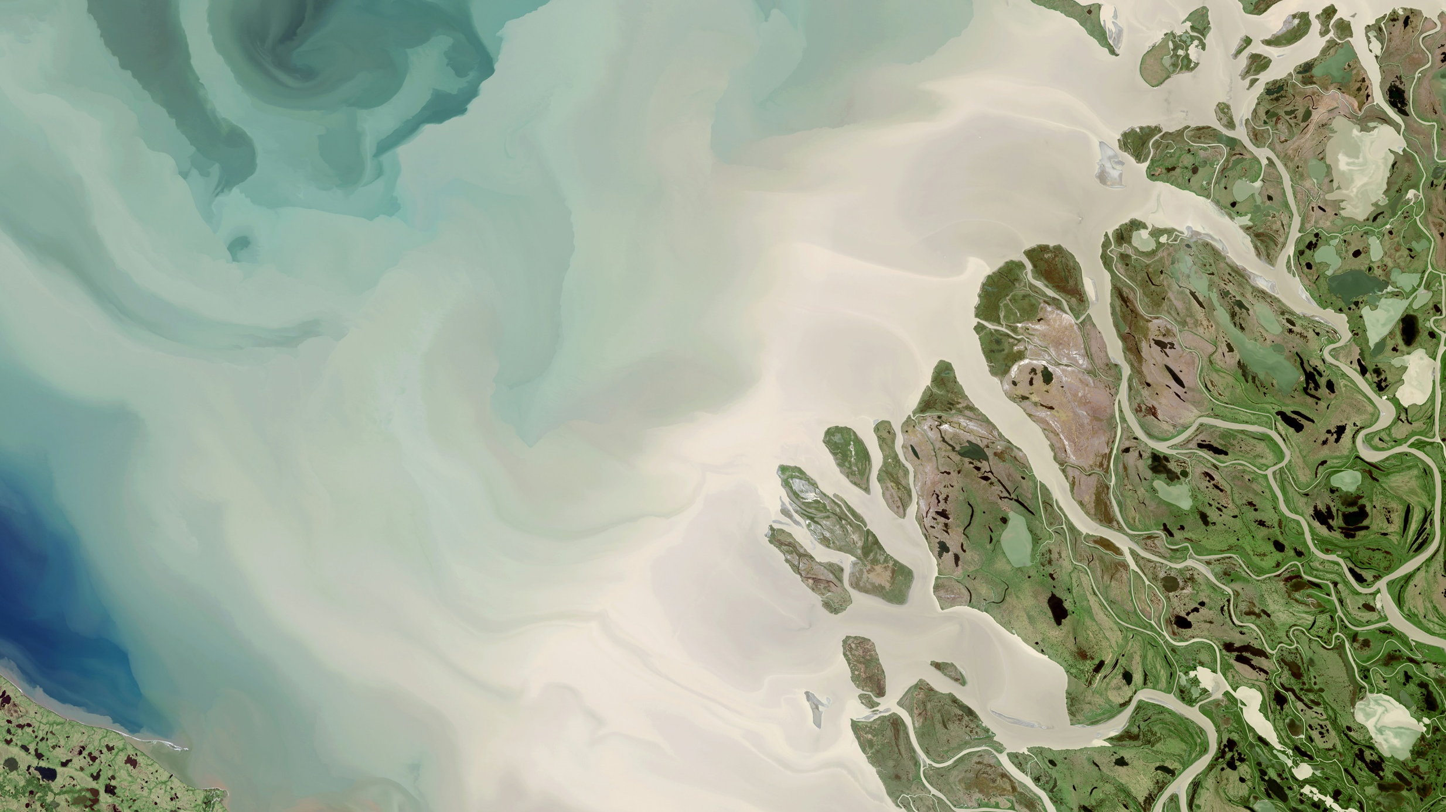
“If we turn inputs into a GeoDataFrame… doesn’t everything else just plug in from there?”

Slide 9
They are still just scripts
Scale, reusability and accessibility
Open-source Python tools are powerful, but they come with some limitations:
Not everyone knows python
They’re hard to reuse across teams or projects
Doesn’t scale easily
Most devs outside the geospatial world have never touched .shp files or worked with projections
Notes:
Not user-friendly and require deep knowledge of python and relevant geoprocessing libraries
They’re hard to reuse across teams or projects
Doesn’t scale easily
Most devs outside the geospatial world have never touched .shp files or worked with projections

Slide 10
“The tooling’s solid — how do we make it accessible, scalable and reusable for everyone”
Notes:
I wanted to make it easy to process spatial data so that anyone could do it
We start by making an API so that we can abstract away all that difficult spatial stuff
Enable regular devs to build and integrate spatial flows into their apps
We need it to be accessible
keep things open-source
Modern and scalable so that it can be used at an enterprise level and not just in a GIS Team silo

Slide 11
Making it scalable and accessible
Building an API
Wrapping python-based geoprocessing workflows in a web API
Making it enterprise compatible
Flask/FastAPI to create the API interface
Gunicorn + Celery + Redis for multithreaded, async task processing
Docker making it easy for you to deploy
Cloud services (Azure) for auto scaling
all available open-source – (url at the end)
Notes:
So that’s what we did, we built an open-source api around that geodataframe concept
And then to make it enterprise ready we set it up with:
Flask is a python web server
Async processing and multithreaded support
Means that if we have a long running process it happens separate to the web server
Common to handle large data in GIS
Docker container architecture for scalability and ease of deployment
And it all works very well for deployment into a cloud host like azure

Slide 12
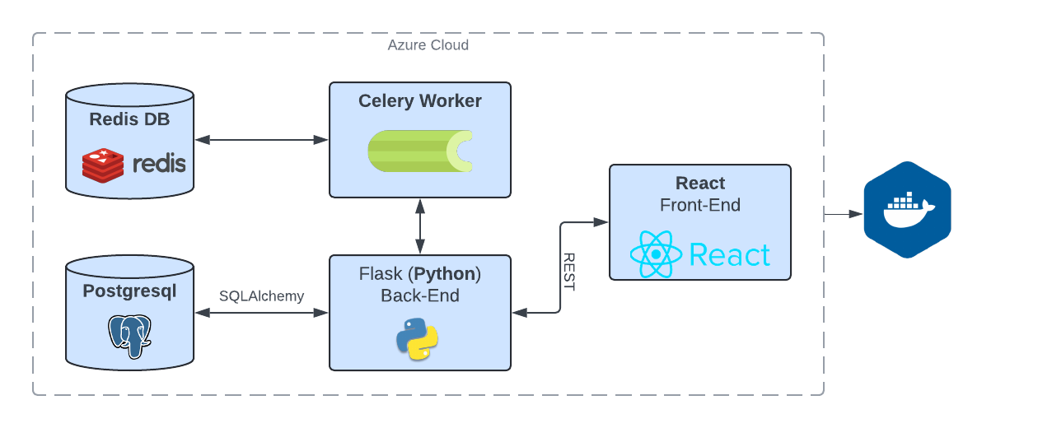
The Architecture
Who doesn’t love a good diagram
all available open-source – (url at the end)
Notes:
FastAPI is a python web server
Async processing and multithreaded support
Means that if we have a long running process it happens separate to the web server
Common to handle large data in GIS
Docker container architecture for scalability and ease of deployment
And it all works very well for deployment into a cloud host like azure

Slide 13
Putting a face on it
Geoflip user friendly front-end
Making it easy to use
React web application
Upload > Transform > Output
All powered by open-source python libraries
api available open-source – (url at the end)
Notes:
FastAPI is a python web server
Async processing and multithreaded support
Means that if we have a long running process it happens separate to the web server
Common to handle large data in GIS
Docker container architecture for scalability and ease of deployment
And it all works very well for deployment into a cloud host like azure

Slide 14
Learnings and Next Steps
Where do we go from here?
What I’ve learned
Open-source tools can absolutely match enterprise capability
The barrier isn’t functionality — it’s accessibility and understanding of GIS fundamentals
A standardised processing model (GeoDataFrame) simplifies transformation
It’s still really difficult to explain what GIS is
As for next steps..
Open-source our UI + Open-source FME server anyone?
Notes:
Is there any interest in an open-source FME server?
Modern and scalable architecture
Core of our api is available open-source already but it would be nice to have a gui and management around it that could be used as an alternative to fme server
Looking for interest before we start building anything

Slide 15
Thank you!
https://github.com/intelligis-io/geoflip-open
nicholas.chai@outlook.com

